Slide 1
Underwater Object Classification Using Deep Learning
Faculty of Science and Technology, Dept. of Computer Science
Undergraduate Thesis
Student Name | ID
Mosrin Tasfia Armin | 18-36019-1
Barman Sourav | 18-36696-1
Ahmed Shahriar | 18-36926-1
Istiaq Md. Jamil | 18-37918-2
Supervisor: | Dr. Debajyoti Karmaker, Associate Professor, Dept. of CSE, AIUB
External: | Md. Nazmul Hossain, Lecturer, Dept. of CSE, AIUB

Slide 2
Content
Introduction
Background Study
Research Questions
Research Methodology
Experimental Procedure
Results
Limitations
Future Work
Reference

Slide 3
Introduction
In this new technology era scientists working on an important sector which is underwater object visualization and data collection. For this research, image processing techniques and deep learning methods are getting used.
While doing underwater researches, researchers face problems about underwater object detection and identification. To solve those problems sector wise researches are ongoing
Problem Definition:
While detecting any object, clear image and visual output is essential which has problem factors to solve while getting the output.
Underwater environment and spontaneous change in surrounding creates obstacle to research where analyzed solvency is a must.
Problems to solve on discovering new underwater species while getting visual data
Importance:
The research is important in order to learn about underwater environment which needed for ecological cyclic research and balancing environmental states

Slide 4
Motivation/Background Study
Motivation:
The core interest to conduct this research is to use Computer Vision knowledge and Machine Learning techniques to solve the basic problem factor of analyzing visual data of underwater or deep sea objects. The motivation is to use deep learning methods on image classification process which helps to conduct researches on object recognition and identification later object spotting research in underwater adverse environment.
Background Study:
Numerous researches were conducted in previous on image classification and object recognition process. The points which involved directly in this research is defined below
Image classification process assigns images on topical classes [1] in network models.
Pretrained network model with big datasets such as VGG[2], ResNet[3], AlexNet[4] are used in underwater image classification
Transfer Learning [5] is used for pre-exposed output transfer process on new network models

Slide 5
Research Questions
Every research gets conducted based on the basic research question. The following research is based on following up questions
In which research area the experimental research is standing?
Why the research is getting placed?
Why the pretrained network model and dataset is used?
Why the approached theorem/model is applied in the experiment?
What results came as outcome?
How the conducted research improvises previous research?
How it enlarge the research aspects in Oceanology and Aqualife?

Slide 6
Research Methodology
For the underwater image classification process deep learning pretrained models are used which are VGG16 and ResNet50. This models are pretrained with large datasets. In order to work with these pretrained models Transfer Learning is used .
Transfer Learning:
Transfer Learning is a machine learning approach that utilizes and transferred information obtained in prior tasks to tackle a new problem. The process improvises to learn new tasks from the transferred knowledge of previous trained tasks. Here is the approached workflow diagram
Figure 1: Transfer Learning Approach

Slide 7
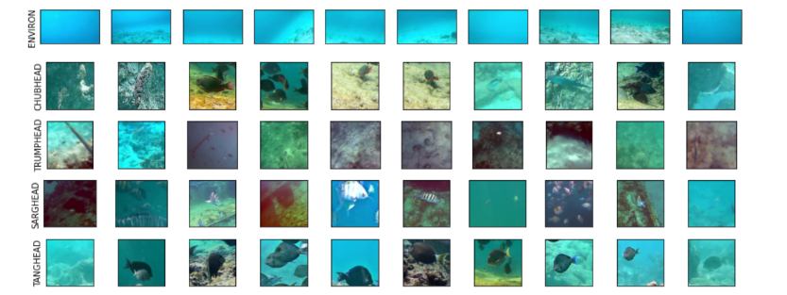
Dataset
An open-source data set is used from Kaggle [6] for the experimental procedure.
It is 5 classes of 3.4k image dataset
Dynamic dimensioned images are resized to 100x100
For training model there were 2504 image and for validation there were 455 images
Figure 2: Dataset Images (Five Classes)

Slide 8
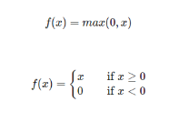
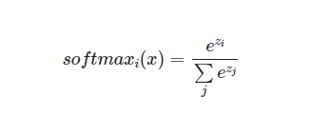
Model Learning Process
There are 2 pretrained model used in the experiment which are (i) VGG16, (ii) ResNet50
VGG16
For training purpose ImageNet is used as weight file
“Include Top” is set to False to remove the classification layer while it was trained on ImageNet dataset
For pooling layer “GlobalAveragePooling2D” is used in the experiment
To produce quicker and higher performance in training process ReLU is used as default activation function inn neural network
Softmax function is used in classification neural network for output layer
For measuring the loss function “sparse categorical crossentropy” is used

Slide 9
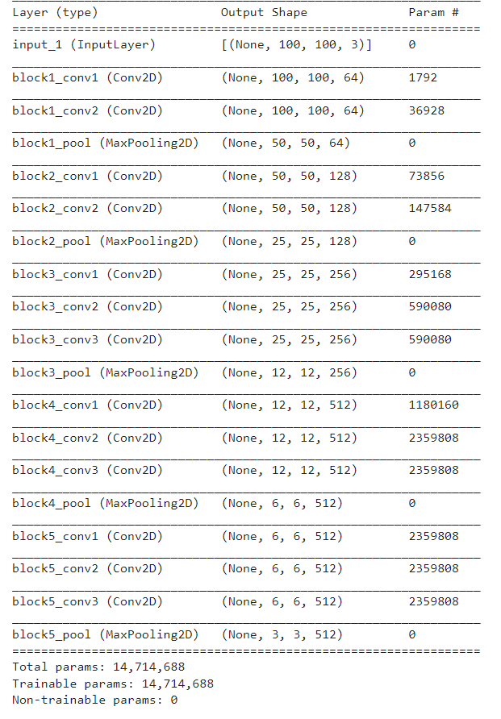
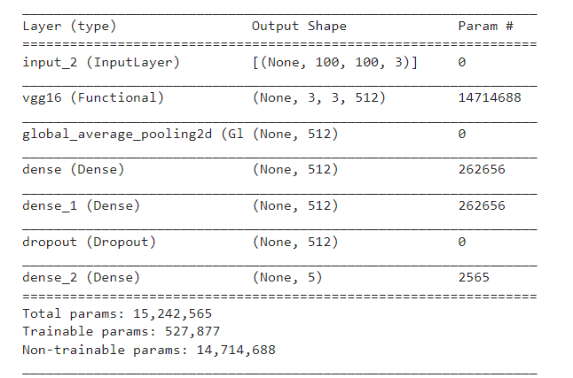
Model Learning Process
Figure 4: Output Format in Last Layer of VGG16
Figure 3: Pretrained model of VGG16

Slide 10
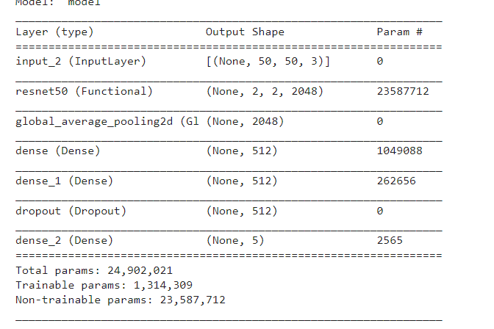
Model Learning Process
ResNet50
The model is used as pre-preprocessed input
For training purpose ImageNet is used as weight file as well
Data Augmentation was done by “ImageDataGenerator”
Weight file is used as a backpropagation
Figure 5: Output Format in Last Layer of ResNet50

Slide 11
Classification Prediction

Slide 12
Result
The experiment was done on both physical and hardware devices.
In online platform “Kaggle” the image size was 224x224 for resource limitation
In physical device(NVIDIA RTX 2060) the image size was 50x50
Achieved Output
Name of Model | Train Accuracy | Train Loss | Validation Accuracy | Validation Loss | Test Accuracy | Test Loss
ResNet50 | 95.47% | 0.11% | 90.23% | 0.30% | 94.11% | 0.29%
VGG16 | 91.21% | 0.23% | 89.84% | 0.37% | 88.24% | 0.57%

Slide 13
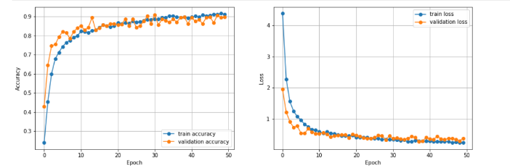
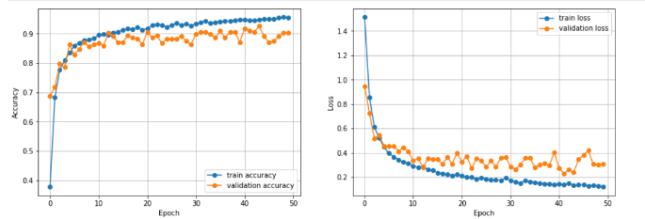
Result (Illustrated)
Figure 6: VGG16 Result Graph
Figure 7: ResNet50 Result Graph

Slide 14
Result (Comparison VGG16 vs ResNet50)
VGG16 | ResNet50
16 deep layer | 50 deep layers
Fully connected | Skip Connection
Maxpooling | Convolution block AVG pooling
Backpropagation update a weight, loss decrese | Gradient=1, doesn’t update weight

Slide 15
Limitation
There are some limitations in the conducted research which are
In the projected experiment 5 class category of deep sea lives, object and environmental data were used which creates a limitation. Increasing data class can process a better output.
Newly trained model without any preprocessed data can not be approached in a pre-preprocessed model which is why custom image data can not be trained for any specific output.
Better pretrained model with a huge number of dataset couldn’t be approached for experimental procedure because of limited resource.
Pretrained model layer architecture with traditional approaches acted as obstacle in the experiment.

Slide 16
Future work
The experimental outcome can be used in some future research scopes which are
The outcome can be used in other pretrained model aside from ResNet50 and VGG16 using Transfer Learning
The result can be used in discovering new object or species in the underwater similar as dataset trained environmental images comparing the on hand output
New techniques can be approached on the projectile experiment in order to achieve better performance acquisition
The output layer data can be an use on creating a new neural network model

Slide 17
References
[1] Lillesand T, Kiefer RW, Chipman J. Remote sensing and image interpretation. John Wiley & Sons; 2014.
[2] Qassim, H., Verma, A., & Feinzimer, D. (2018). Compressed residual-VGG16 CNN model for big data places image recognition. 2018 IEEE 8th Annual Computing and Communication Workshop and Conference (CCWC). doi:10.1109/ccwc.2018.8301729
[3] He, K., Zhang, X., Ren, S., Sun, J.: Deep residual learning for image recognition. In: Proceedings of the IEEE conference on computer vision and pattern recognition, pp. 770-778. (2016)
[4] Krizhevsky, A., Sutskever, I., Hinton, G. E.: Imagenet classification with deep convolutional neural networks. In: Advances in neural information processing systems, pp. 1097-1105. (2012)
[5] Pan, Sinno Jialin; Yang, Qiang (2010). A Survey on Transfer Learning. IEEE Transactions on Knowledge and Data Engineering, 22(10), 1345–1359. doi:10.1109/TKDE.2009.191
[6] https://www.kaggle.com/hiyaro/bluenetpenta

Slide 18
Thank You
Q/A Session

